Slide 1

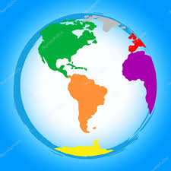
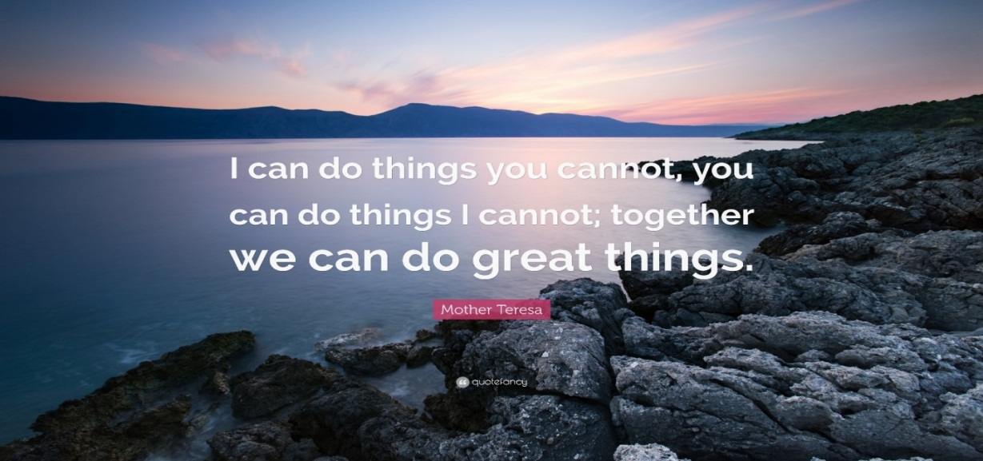
École Notre-Dame Sahel-Alma
Des Soeurs Maronites de la Sainte Famille
What would you do to change the World ????
2 0 2 0
Visions …
Collège Notre-Dame
English magazine
Since the turn of this decade, the new Lebanese generations have felt the pressure building up inside of them. Their dreams and aspirations coincide with the cries and agonies of the world. And like other teens in other parts of the world, they continue to face big changes in society. Are they brave enough to speak up and never give up?
Here is the new wave of change our EB9 students are carrying:

Slide 2
École Notre-Dame Sahel-Alma
Des Soeurs Maronites de la Sainte Famille
What would you do to change the World ????
2 0 2 0
We often tend to admire people and their achievements,
nagging about it being a matter of luck,
or God choosing them over you, planting special gifts into them,
giving them the right opportunities to show their best selves.
When what we should really do is forget about other people and consider them your competition, and only remember the only competition you will have to face daily is the one between you and the person you were yesterday. When all of these are beautiful, deeply meaningful words, what could you possibly do to change something in this world, and to quote Lord Baden Powell ‘leave this world a better place than you found it.’?
I want to believe we were all put into the world for a certain purpose, that might be changing it. But not everyone’s way to achieve it will be the same, because I want to believe everyone has his own personal touch and own way of doing it. Some of us might change the world into teaching it to others, so they could assimilate their wisdom and have their beliefs based on a person’s full life-experience.
Others, as a matter of fact, might start working on their goals by working on themselves, and progressively change the world by changing themselves, and their entourage. On a more personal note, I think I might change the world by learning as much as I can while I am still young and make all this hard work flourish when I become older. I would also want to teach younger people how to think in a positive way and hopefully have the strength to teach them so as not to make the same mistake and start the growth from that point. I would finally want to show my impact into publishing some of my thoughts, so people can read about what happened in my life, in that specific time and space situation, so that it will always be remembered, even if I am not the one telling these stories, but rather papers and books.
To wrap up, it is nice to think you will leave something behind you after you’re gone, so your presence isn’t limited to a timeline or space, but rather expending as the years pass. I hope everyone will realize how precious and important it would be to change the world in your own way.
Suzanne WADIH – Grade 9
April 2020

Slide 3
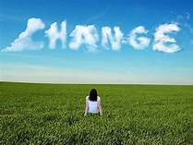
École Notre-Dame Sahel-Alma
Des Soeurs Maronites de la Sainte Famille
What would you do to change the World ????
2 0 2 0
The world we are living in today is completely different from the one our ancestors lived in over a hundred years ago. Over these years we have seen extraordinary changes in technology; we wished to be like birds flying here and there; now we are striving to visit planets and isolated areas. Back then, they dreamed of going around the world in eighty days, now we communicate across the world in seconds. The culture of the people changes with the development in science and technology. Nevertheless, with every development the society achieves, come some negative effects. Pollution and global warming are the best examples caused by these changes.
If I could change the world, I would start by doing changes in our living standards in order to make this world a better place to live in: everything would be powered by renewable energy… I would convince people to start recycling and implementing new ways to prevent pollution and global warming. Furthermore, I would change the education system to make it more suitable for students. In fact, most of the students are wasting years of learning things they won’t even use in their professional lives, so I’d make schools focus more on the student’s creative abilities and only give the learner what he really needs further in his life. Finally, I would end world hunger and poverty by forcing every government to donate basic needs for them to live in a decent lifestyle.
To conclude, our world really needs a change. But this change won’t happen if there’s still ignorant and lazy people relying on others. Everyone should start investing in his time to make our living better, like recycling, respecting the environment and the people, and feeling with others, etc.…
Yorgo JREIJE – Grade 9
April 2020

Slide 4
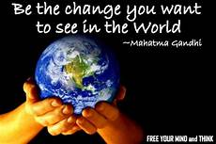
École Notre-Dame Sahel-Alma
Des Soeurs Maronites de la Sainte Famille
What would you do to change the World ????
2 0 2 0
As a teenager, I think the world is what we go through in life. In order to achieve all our goals, we should take risks because we are the future of this world. Everything that is happening right now is preparing us to become stronger and to face anything in life. We are referred to sometimes as troublemakers but who said we cannot change the world in our own way?
Every teenager is judged by his parents, his friends or any other person without having any clue about what this kid has or can offer because in life everyone has his own opinion and can do whatever he wants as long as it makes him happy. Therefore, we should strive to enlighten every adult in this world and let them know that we should not judge a book by its cover because many people gave up on their dreams when they were discouraged or criticized.
Teenagers should try to work on their dreams and at the same time teach the adults to stop judging people and, in that way, we will build a better future with peace and love.
We are the change.
Angy MAKHLOUF – Grade 9
April 2020

Slide 5

École Notre-Dame Sahel-Alma
Des Soeurs Maronites de la Sainte Famille
What would you do to change the World ????
2 0 2 0
Changing the world doesn't need millions of dollars ; it's in the little things. This seems crazy, weird, hard but it's possible. We're all in this together. And each one of us can change it in his own way.
To change the world, I would change humanity, because I see humans but not humanity.
And how can I do this ?
A simple smile to light up someone's day, passion in everything I do, courage to overcome my fears, touching other's soul in my words and acts. And most importantly, empathy because if we lose it, we will lose our humanity.
Rénata CHIHANE – Grade 9
April 2020

Slide 6
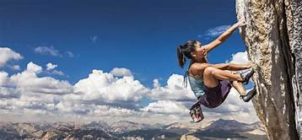
École Notre-Dame Sahel-Alma
Des Soeurs Maronites de la Sainte Famille
What would you do to change the World ????
2 0 2 0
We are living in a world where there are a lot of
things that should be changed. People’s minds
only focus on business, deals and money…
People are forgetting the meaning of humanity and are treating people like objects. We are literally forgetting the goal of our lives.
I know that sometimes bad things happen, and we cannot do anything about them. All we can do sometimes is to cry but we can never change the past.
I think we need to wake people up to the real meaning of life and the importance of living, of chasing our dreams, of making them real, and of telling them about the family’s values and that time is gold.
I would tell them with a loud voice so everyone can hear:
Time is running! Don’t let it go without being proud of what you did!
Live like you want to. Do the things you love. Tell the people around you that you love them at all costs.
Live a life you will be proud of. Give yourself a name that people will shout in the streets and be proud of. Let your good actions be written in history.
Take your rights but fulfill your responsibilities first!
Listen to others and let the others listen to you. Be respectful so you oblige people to respect you.
Let the wars and the fights be over, AND LOVE IS THE SOLUTION!’’
Joya EL FAKHRY – Grade 9
April 2020

Slide 7
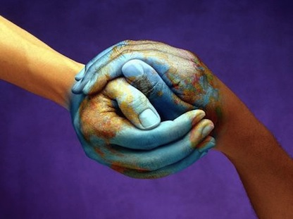


École Notre-Dame Sahel-Alma
Des Soeurs Maronites de la Sainte Famille
What would you do to change the World ????
2 0 2 0
When I first read ‘’what will you do to change the world?’,
I thought it’s a really hard question, but after watching the video, this man proved to me that we can change the world with little acts, but the most important thing is to do them with love.
Maybe help someone to study or listen to somebody, be there for our friends.
I want to make the world a better place by spreading positivity as much as I can and helping others. Maybe I won’t make a big difference, but at least I’ll make some people happy.
Many small people, in small places, doing small things can change the world.
Eduardo Galeano
Changing the world isn’t about accomplishing BIG things; it just needs small acts done from the bottom of our hearts! ☺
Many small people, in small places, doing small things can change the world.
Eduardo Galeano
Pia-Rita KRAYMATI – Grade 9
April 2020

Slide 8
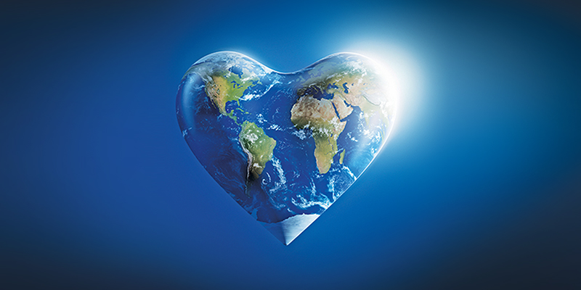
École Notre-Dame Sahel-Alma
Des Soeurs Maronites de la Sainte Famille
What would you do to change the World ????
2 0 2 0
The world is a gift from God, and we should
make it a better place. I want to change the world, I really do, and I hope one day I will achieve this goal. Yes, one person can change the world. We must just put some hope in our minds and never miss the opportunity of having a wonderful place to live in.
Complaining will not make things better, so I think the most important thing to do is to share positivity because sadly, we live in a society where everyone reacts in a negative way.
So, do you really want to change the world? Well, start by changing yourself into someone brave enough to speak up and take actions; and this is what I am trying to do.
In addition to that, I started recycling a while ago, and I stopped polluting, as many other people stopped too.
Mahatma Gandhi said: “We should be the change we want to see in the world” Changing the world is not that hard, because when someone starts with something small, it could spread.
Joy EL TANNOURY – Grade 9
April 2020

Slide 9
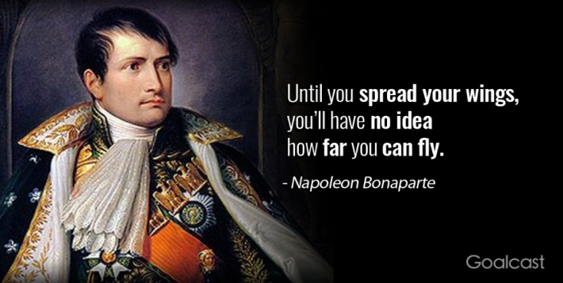
École Notre-Dame Sahel-Alma
Des Soeurs Maronites de la Sainte Famille
What would you do to change the World ????
2 0 2 0
Spread your wings
I truly think that in order to change the world, we must change ourselves, our behavior, and the use of our resources. Planet earth is in danger, and for us to be able to save it, we must act and start sacrificing. We are never too young to make a difference. We just have to believe in what we are doing and try to spread our energy all around us. As Eduardo Galeano said: “Many small people, in small places, doing small things, can change the world.”
The younger generations are the ones that are capable of change simply because we can love. We hold in our hearts love to our future, to our dreams and to our planet and, therefore, we are willing to act.
Global warming is one of the biggest threats to our world and in order to save our planet, we must be united, and change the negative thoughts and hatred that we carry inside of us.
Changing the world involves many different scales on a personal level. It includes smiling to strangers, holding back our rage during small meaningless problems and even big ones; it is putting ourselves in others’ shoes and understanding their behavior; it is helping others and caring for each other. Only a wise person can understand that changing the world isn’t about voting for the right president or leading the best campaign or inventing the best logos, it is about bettering every individual by himself in order to create a community that doesn’t care about appearances and money and material stuff, but about the deeper meaning of life.
Changing the world is both easier and harder than we thought. And as Ghandi said: “In a gentle way, you can shake the world”.
Ghinwa YOUNES – Grade 9
April 2020

Slide 10
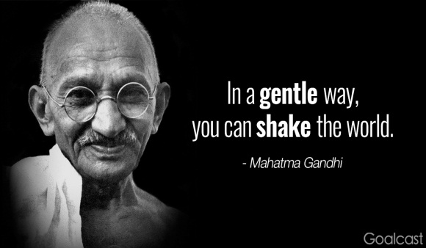
École Notre-Dame Sahel-Alma
Des Soeurs Maronites de la Sainte Famille
What would you do to change the World ????
2 0 2 0
Whenever I am asked this question,
I panic because for me, this is something huge.
Being a little drop in the gigantic sea, I must do something to change the big, big world: isn’t it terrifying? Well, after a lot of thinking, my answer is no, I cannot change the world, but I can do something much more important.
A confident, determined, and positive person can achieve any goal he has in mind, and with everything happening in our country and all over the world, this is what we need to face this hard situation. Sadly, we live in a society where everything is taken in a negative way, where human rights are almost forgotten, and where you must act and think in a selfish way to save yourself and stay alive.
However, we must stay positive and begin with the first step of making our world a better place: changing ourselves. This is what I am trying to do, and what everyone of us should do in order to change our world and make it great for the upcoming generations. Believe in yourselves, in your thoughts and in your acts; be brave enough to speak up and take actions and finally never ever give up.
Finally, our world is a gift from God, and we have to benefit from it while taking care of everything around us and not polluting and destroying this beautiful present from our creator.
Thia Maria FADEL – Grade 9
April 2020

Slide 11
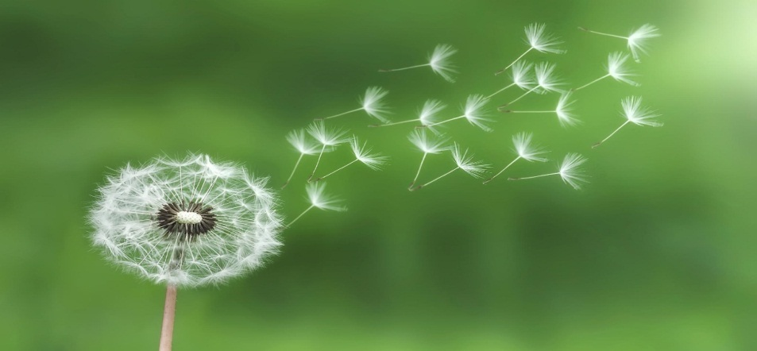
École Notre-Dame Sahel-Alma
Des Soeurs Maronites de la Sainte Famille
What would you do to change the World ????
2 0 2 0
Our biggest problem is that we transform
all the simple situations into complicated ones knowing in fact they are not worth it. WHY? Just because our heads are full of negativity and anger. We are complicating our lives, filling our heads with so much negativity. Wouldn’t it be far better not to exaggerate our reactions?
It is that simple. We, humans, always focus on the negative points in life and complicate things, believing we are doing the right thing. Just relax, take a deep breath, think, try to see all the blessings God has put in your life. Trust me, things would be much better if you look on the bright sides. You might be asking yourself: what will I do to change the world? The answer is: I will spread positivity all around me to prove to you all that you count in this world and God created you for a reason.
Every person needs to be encouraged and feel loved. To change the world, I will be that person who will encourage you, give you positive vibes and advice. Know when you need me that I will be there for you.
Put it that way: if every person felt loved and reassured, then the world would be a perfect place to live in.
Rachèle ZGHEIB – Grade 9
April 2020

